Slide 1

SlovakEye
DanubeHack 2.0
2016
Jakub Kočica, Tomáš Kliment

Slide 2
What is the aim?
We want to explore the quality of our landscape in scale of the region
We have open data from ESA´s Sentinel 2 mission
We want to share our data and help other researchers in the topic of remote sensing

Slide 3
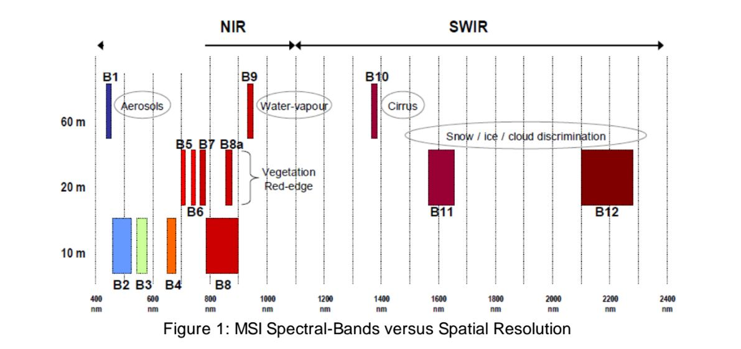
Sentinel 2 characteristics
Sentinel 2 is optical high resolution mission of European Space Agency (ESA)
There are two satelites observing earth in the interval of10(5 days)

Slide 4
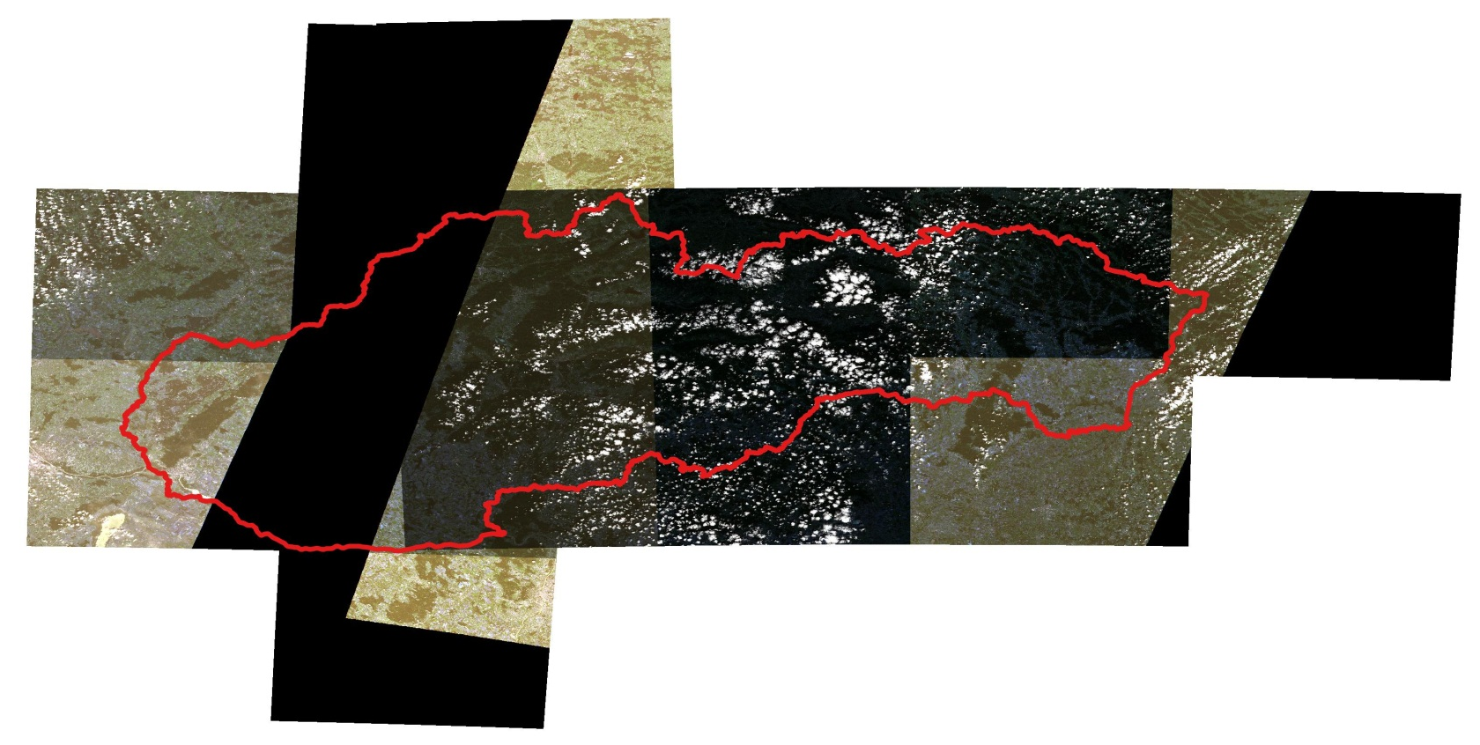
Input data
Sentinel 2 L1C 2x2 tiles (observed 25. 06. 2016 )
Selection for Slovakia = 13 sub-tiles

Slide 5
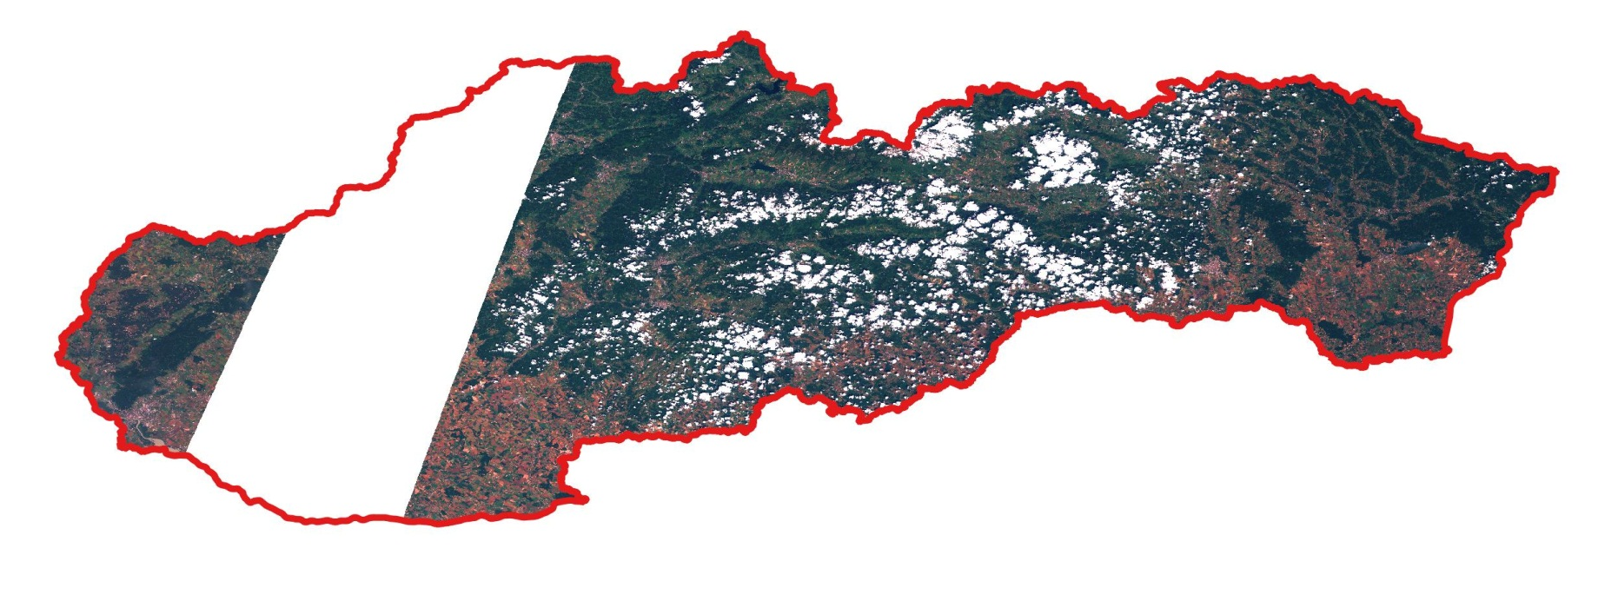
Processing
Merging bands 2 – 8a into single raster layer
Resampling original 10 (20)m resolution to 50 m
Merging raster layers into single one
Clipping

Slide 6
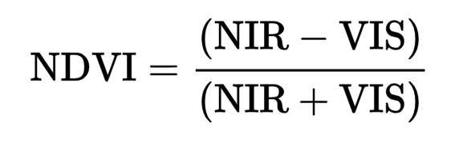
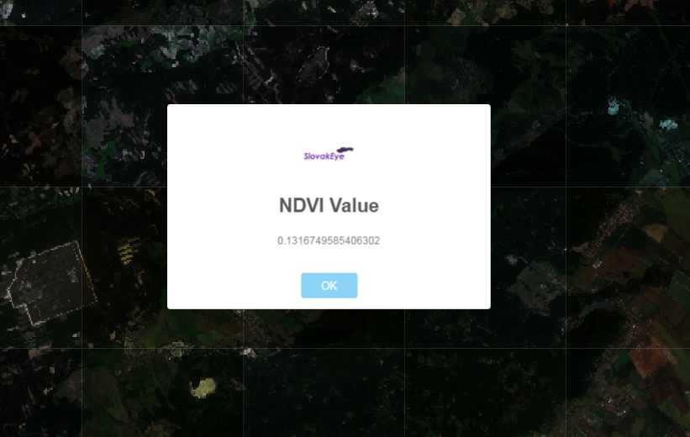
NDVI estimation
NDVI calculation on the client side
http://bolegweb.geof.unizg.hr/danubehack2/slovak-eye/

Slide 7
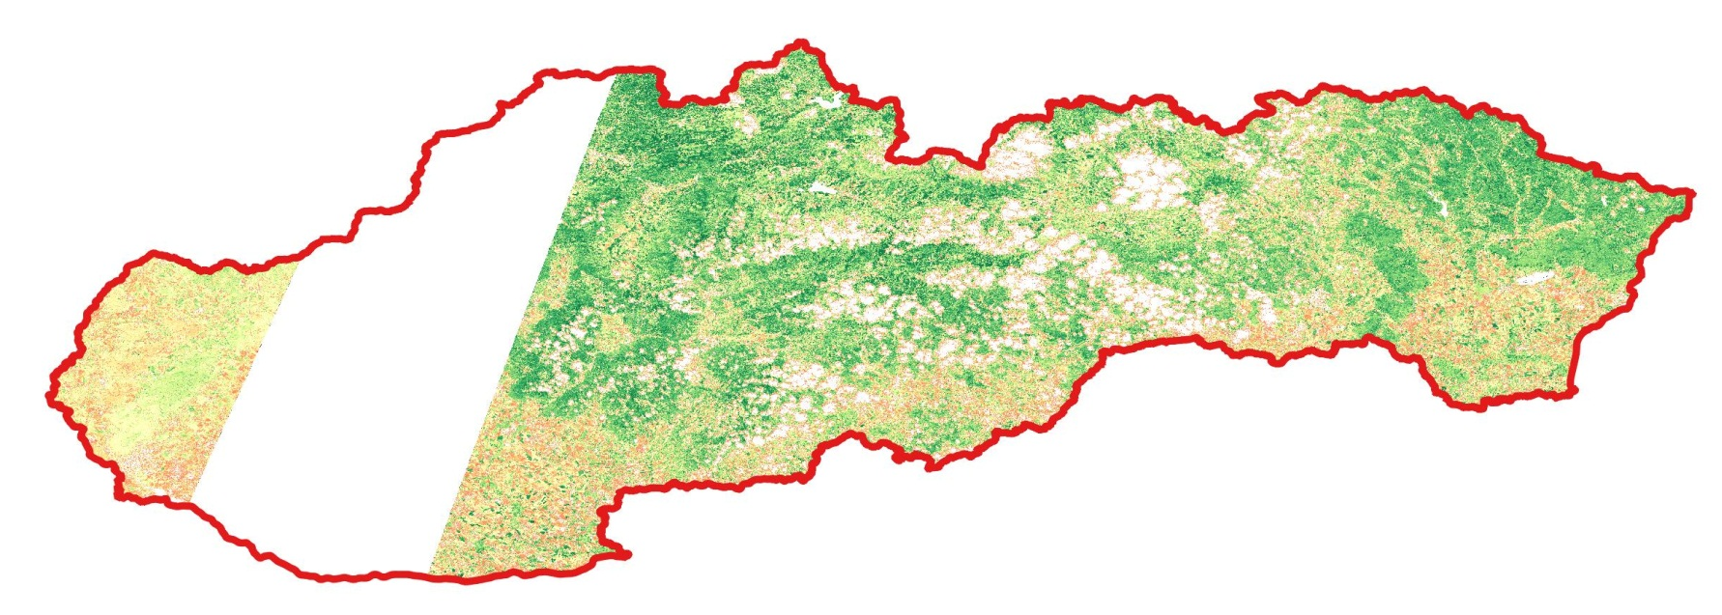
Publishing
Dataset is published trough GeoServer and available for download by WCS
http://data.datacove.eu:8080/geoserver/slovak-eye/wcs?service=WCS&version=2.0.1&request=GetCapabilities

Slide 8
Thank you for attention!

